Slide 1
THE FHA REVERSE MORTGAGE UPDATES FOR 2016
FHA HOME EQUITY CONVERSION MORTGAGE (HECM)
Presented By
Doni Dolfinger
Reverse Mortgage Specialist
6775 E. Evans Ave., Denver, CO
(303) 791-4786 or (303) 378-8905
ddolfinger@ulc.com
License # 100017629
NMLS # 266569

Slide 2
REVERSE MORTGAGE What is it?
Loan for Homeowners 62+
Convert portion of home equity into tax free income.
No need to
Give up title
Make Mortgage payments
Provides additional financial security to fully enjoy retirement years.

Slide 3
REVERSE MORTGAGE DIFFERENCE
No monthly payments.
Use the money however the borrower(s) desire.
Loan must be repaid when borrower(s):
Move
Sell
Refinance
Die

Slide 4
REVERSE MORTGAGE DIFFERENCE
One homeowner must be at least 62
Any existing mortgage has to be paid
Attend counseling session with HUD-approved housing counselor.
Home must be a 1-4 family residence
Condo projects must be FHA approved.
Manufactured homes acceptable, must meet FHA guidelines.

Slide 5
REVERSE MORTGAGE PROGRAM CHANGES
Non-borrowing Spouse – Spouse that is not 62 may still be able to remain in the home even if borrowing spouse dies, although they would not be a party to the loan. They would not have access to any remaining reverse mortgage funds if borrower dies.
Financial Assessment – Residual income and credit qualifying to prove willingness and capacity to pay taxes, insurance and debts in a timely manner.
Life Expectancy Set Aside for taxes and insurance (LESA) – if there are credit issues or lack of residual income, a LESA may be required.
Customers must provide proof of information used for loan qualification.

Slide 6
REVERSE MORTGAGE LOAN FACTORS
Determined by:
Appraised value of home or FHA limit, (whichever is less)
Borrower(s) age
Current interest rate
Typically, the older the borrower(s) the more money available (calculations based on a younger person).

Slide 7
REVERSE MORTGAGE LOAN PAYMENT OPTIONS
Borrower(s) design the plan.
Tenure- Monthly payments as long as borrower(s) live in the home.
Term-payments for set amount of time
Line of credit- as requested.
Lump sum
Combination
Options can be changed at any time for $20.

Slide 8
REVERSE MORTGAGE FEES
An itemized estimate of closing costs will be provided.
All loan cost can be financed.
Initial mortgage insurance premium: 2.5% or .50% of maximum claim amount.
Loan origination fee: 2% on first $200,000, 1% on value over $200,000 to max of $6,000.
Typical closing costs

Slide 9
INITIAL MORTGAGE INSURANCE PREMIUM CHANGES
STANDARD –
Higher initial Mortgage Insurance Premium (MIP) to FHA
MIP 2.5% of value or maximum claim amount
LOW INITIAL MORTGAGE INSURANCE PREMIUM –
Lower up front MIP
MIP .50% of value or maximum claim amount
If the initial loan disbursement exceeds 60% of the Principal Limit (the amount available) the IMIP will be 2.50% of the maximum claim amount, if it is less than 60%, the IMIP will be .50% of maximum claim amount.
“Mandatory Obligations” include costs financed, required payoffs and repairs. The total of mandatory obligations determines IMIP.

Slide 10
REVERSE MORTGAGE SECURITY FEATURES
Insured By FHA
House Repays Debt
Non Recourse (Guaranteed No Debt Left To Borrower Or Estate)
Taxes And Insurance Can Be Paid By The Loan

Slide 11
“MUST DO’’ REVERSE MORTGAGE REQUIREMENTS
Keep Property Taxes Current
Maintain Homeowners Insurance
Keep Property In Good Condition
Live In The Home As A Primary Residence
Borrower(s) Retain Ownership

Slide 12
REVERSE MORTGAGE REPAYMENT
No Repayment Necessary Until Borrower(s), Move, Sell, Or Die
No Penalty For Early Payment
No Personal Liability
Borrower Can Make Periodic Payments And Re-draw Funds On The Adjustable Rate

Slide 13
REVERSE MORTGAGE BENEFITS
No Monthly Payments
Proceeds Are Tax-free Funds
Receive Benefits As Long As Borrower(s) Remain In Their Home
Retain Home Ownership
Enhance Retirement Lifestyle/ Provide A Brighter Future

Slide 17
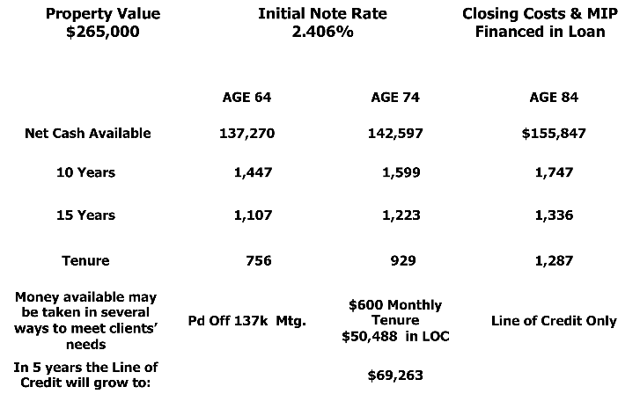
FHA REVERSE MORTGAGE VALUE/PAYMENT EXAMPLES MONTHLY ADJUSTABLE ASSUMPTIONS

Slide 18
WHAT’S LEFT FOR ME OR MY ESTATE?
Assume the 74 year old finances the closing costs, takes $600 a month income, never touches the line of credit and decides to sell in six years:
At 4% appreciation home is worth $335,310
Approximate loan balance - 64,642
Net equity to borrower or heirs $270,668
Rate fluctuation will affect amount owed but will not affect monthly payments to the borrower.

Slide 19
REVERSE MORTGAGE FOR PURCHASE BEGAN JANUARY 2009
Why HECM for purchase?
It allows for 1 transaction instead of 2
Great for RELOCATION
Great for DOWNSIZING
Great for UPSIZING
Financial Assessment Applies
to the Purchase Program

Slide 20
REVERSE MORTGAGE FOR PURCHASE EXAMPLES
JO’S EXAMPLE:
She is 68 years old she netted $191,000 out of previous home.
Interest rate 5.56% on Fixed Rate RM
New Town home $272,373*
Cash from sale of previous home $191,000
Needed to close $ 81,373
Qualifies for $166,000 on her Reverse Mortgage so she has $81,373 for closing; $84,627 to her and no monthly payments. (Cash at closing can be from sale of previous home, investments, gift, cannot be borrowed).
*For purchase mortgages only, the maximum claim amount will be the least of the appraised value; sales price; FHA mortgage limit. These figures included her MIP, Closing Costs and Origination fees.

Slide 21
REVERSE MORTGAGE FOR PURCHASE EXAMPLES
Pam’s example:
She is 62 years old has $500,000 cash in bank
Fixed interest rate of 5.56%
New Patio Home $225,000
New Loan – RM $126,000
Cash needed to close $ 99,000
Figures may change with interest rate changes

