Slide 1
Adobe Acrobat DC
Affinity Consulting
John A. Federico
jfederico@affinityconsulting.com

Slide 2
Introduction to PDFs
Portable Document Format files:
  PDF contains a device independent description of the elements of a printed document needed to display it
  First released June 15, 1993
  In 2008, Adobe:
    Released as an open standard to ISO
    Released public patent

Slide 3
What can be converted to PDF?
Electronic files (Word, WordPerfect, Excel, etc.)
Digital photographs (.jpg files)
Paper documents
Web pages
Email
Something you’ve copied

Slide 4
Important PDF Terminology
Types of PDFs:
  True PDFs or Digitally Created (“Text”) PDFs
  Image-only PDFs (scanned PDFs)
  Searchable PDFs (Image + Text)
    OCR = Optical Character Recognition
PDF/A – PDF Archive Format
Combined PDFs
  Single PDF (Binder)
  PDF Portfolio (successor to PDF Package)
PDF Forms
  Acroforms
  XFA Forms (XML Forms Architecture - Adobe Livecycle Designer)

Slide 5
Types of PDFs
True PDFs
  Created directly from Word or original source
  Text is 100% accurate to original document
  Highest quality PDF
  Usually the smallest PDF
Image only PDFs
  Just an image of original
  Cannot be searched for text
  Default type of PDF from SCANNERS
Searchable PDFs (Image + Text)
  Layer of searchable text behind image (might not be 100% accurate)
  Text searchable
  Indispensable.

Slide 6




Types of PDFs

Slide 7

PDF/A
Type of PDF for long term storage
Must be “self-contained”
Some courts starting to require
Easy to make
Limitations:
  No Encryption
  No audio or video
  Embedded fonts
  No external content references

Slide 8
Why PDF programs are compatible
While Adobe Systems made the PDF specification available free of charge in 1993, PDF remained a proprietary format, controlled by Adobe, until it was officially released as an open standard on July 1, 2008, and published by the International Organization for Standardization as ISO 32000-1:2008. In 2008, Adobe published a Public Patent License to ISO 32000-1 granting royalty-free rights for all patents owned by Adobe that are necessary to make, use, sell and distribute PDF compliant implementations.

Slide 9
Acrobat DC Main Interface
Themes
Three main areas: Home, Tools, Document
4 main toolbar areas
1 secondary toolbar
Basic Acrobat Use: Select Tool, Secondary Toolbar Appears, Perform Action, Close Secondary Toolbar, REPEAT
Customizing Acrobat

Slide 10
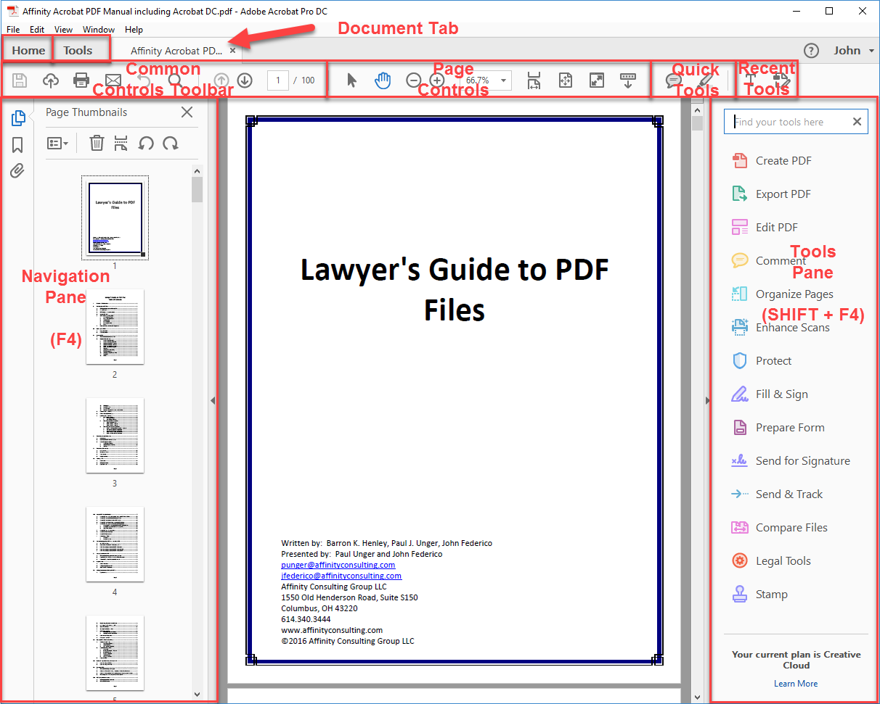

Slide 11
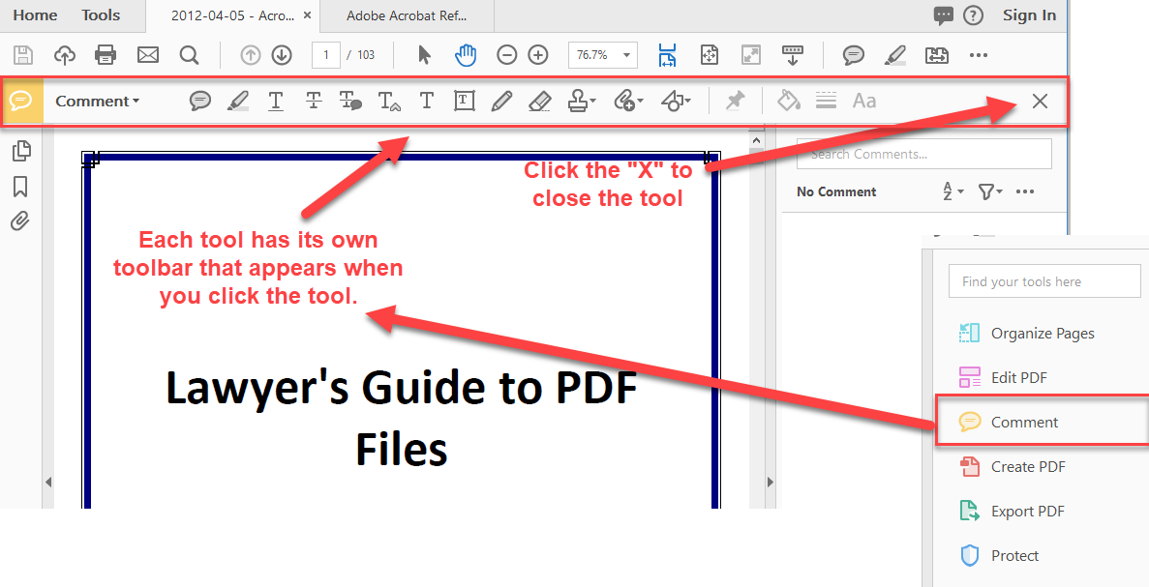
Selecting and Using Acrobat Tools

Slide 12
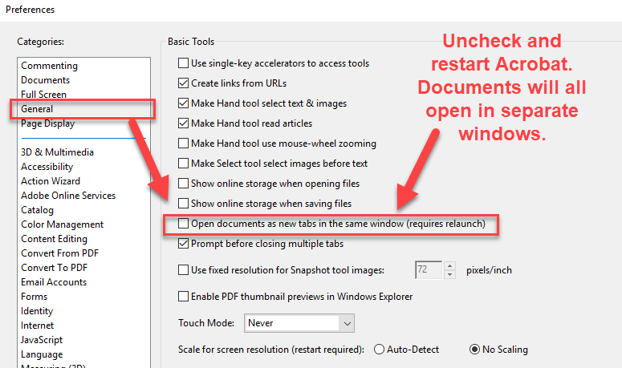
Customizing
“I hate tabs.
I want each document in its own window.”

Slide 13
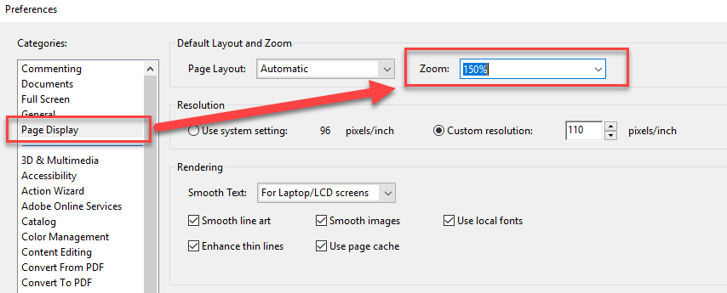
Customizing
“I want the same zoom setting each time I open Acrobat.”

Slide 14
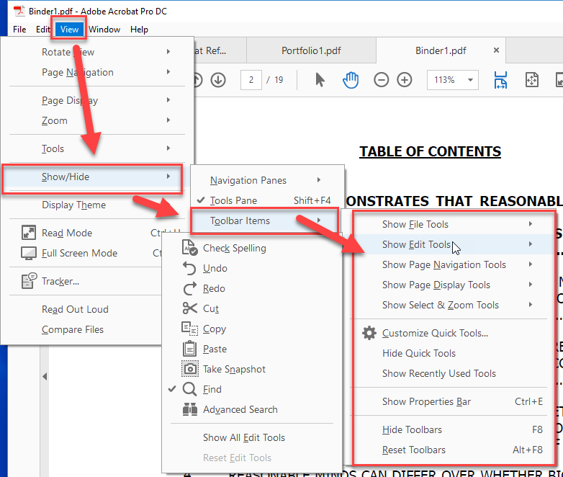
Customizing
“The screen is too busy. How do I hide some of this.”

Slide 15
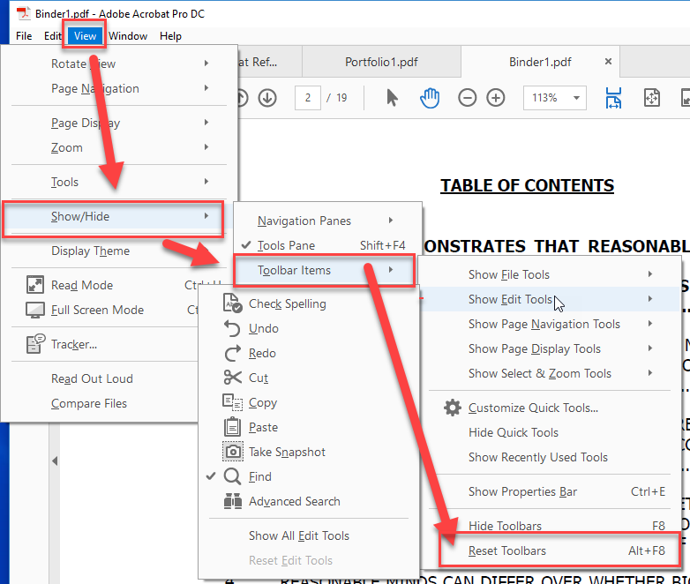
Customizing
“I messed up my toolbars.”

Slide 16
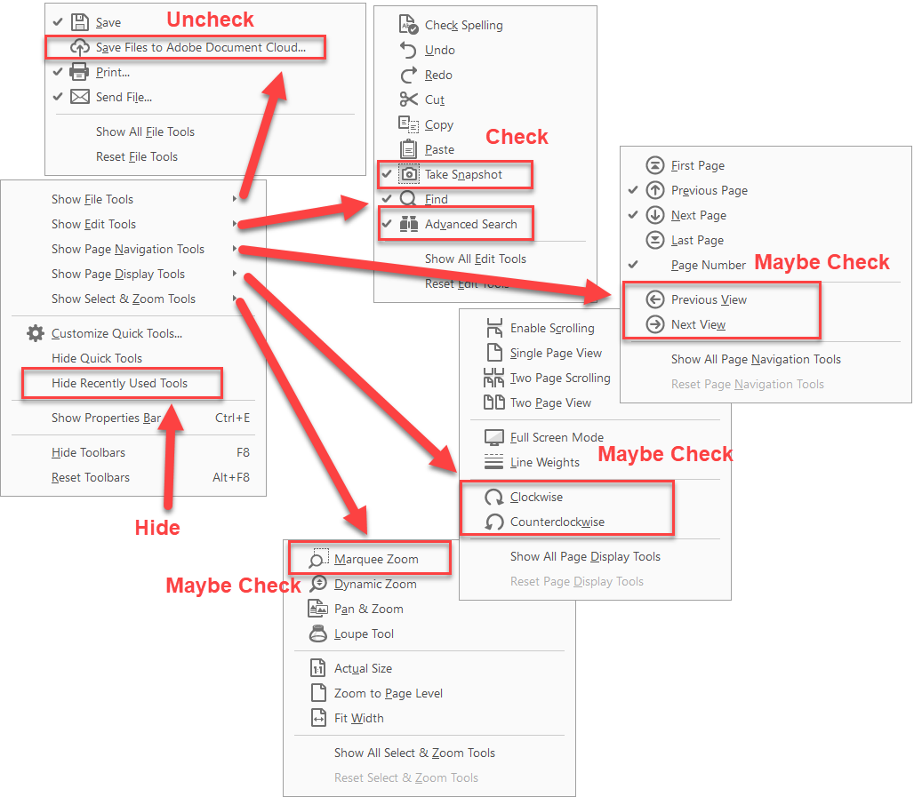
Recommended Customizations

Slide 17
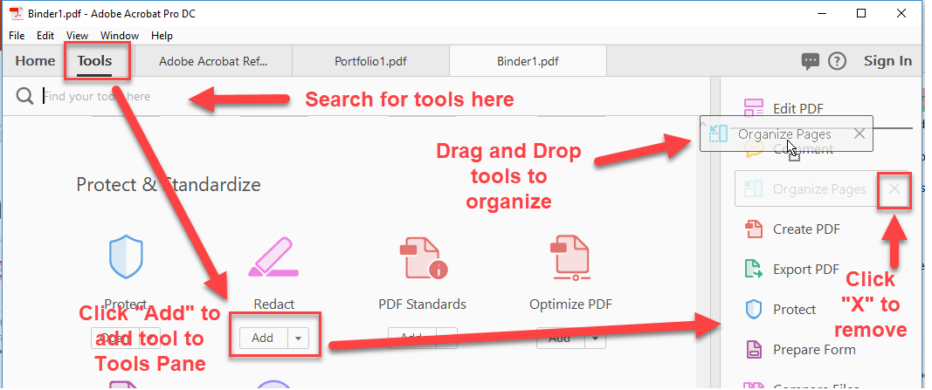
Customizing Tools Pane
Click into the Tools area to configure the Tools Pane.
If you are in a document tab, you will need to right click on the tool to change.

Slide 18
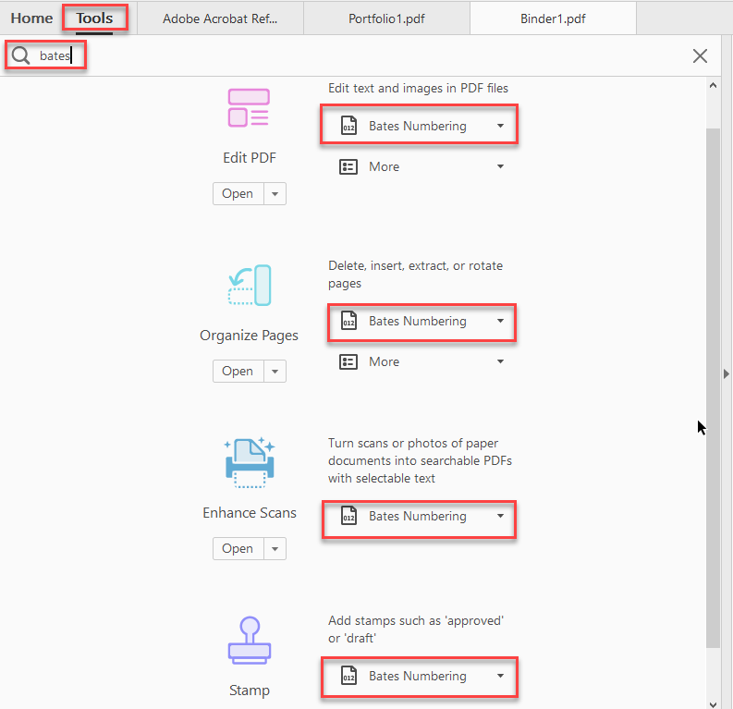
Customizing Tools Pane
Note: The same feature might be in more than one tool.

Slide 19
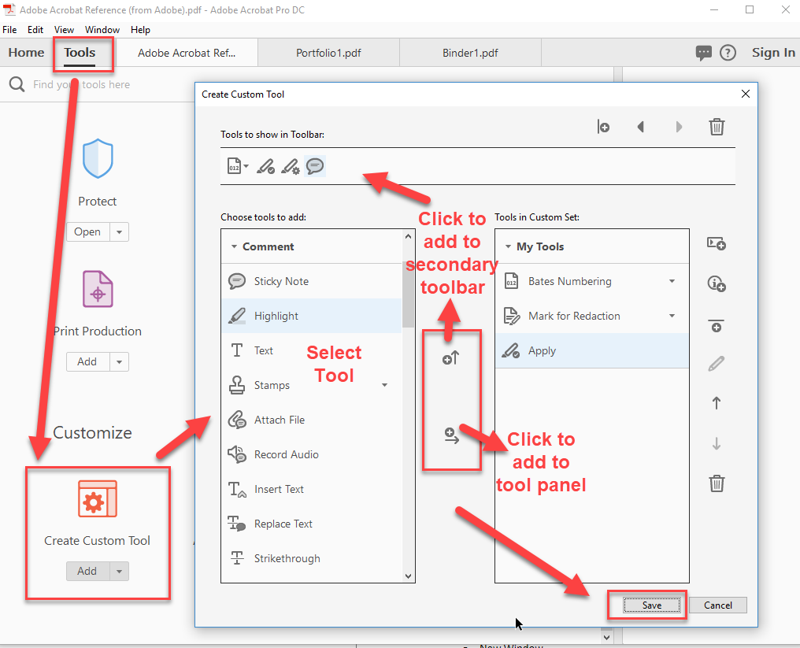
Custom Tools

Slide 20
Viewing/Navigating PDFs
Zooming
Read Mode
Full Screen Mode
Window Menu
  Split
  Spreadsheet Split
  New Window
  Cascade/Tile
Drag and Drop Tabs
Bookmark/Link Navigation
Go to a particular page
Read out loud

Slide 21
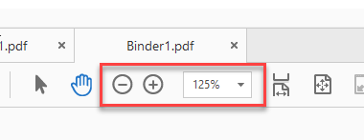
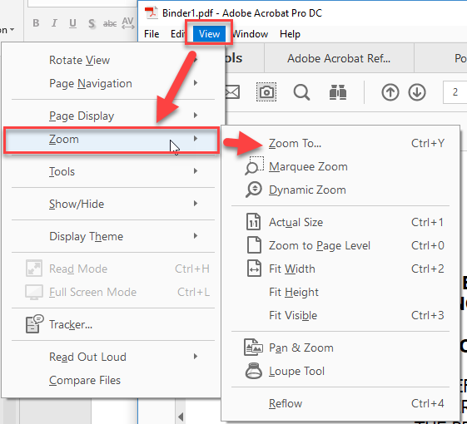
Zoom
+ and – buttons or the zoom control
CTRL + mouse wheel
Miscellaneous tools (Marquee Zoom)
View -> Zoom
Remember you can set your preferred zoom in the options (prior slide).

Slide 22
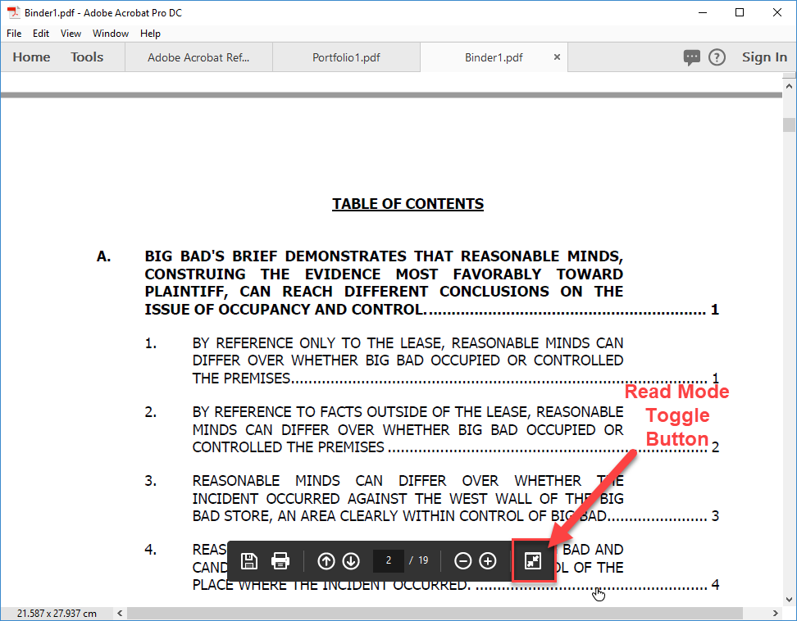
Read Mode
CTRL+H (Hide everything else in the window)
Read Mode hides all toolbars and side panes, and adds a “floating” navigation bar near the bottom of the screen.
Press CTRL + H or Escape or click the
Read Mode button to leave Read Mode.

Slide 23
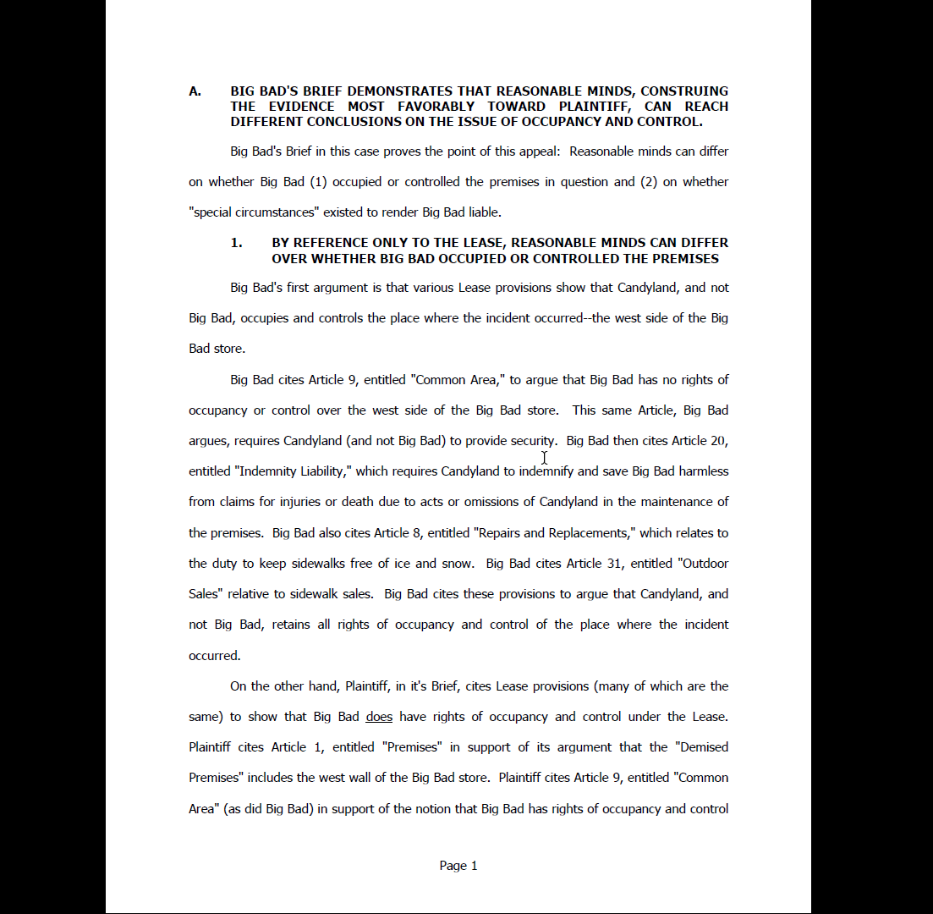
Full Screen View
CTRL+L (Look at the document, and nothing else)
Full Screen Mode takes over the entire screen and displays the document one page at a time.
Press CTRL+L or Escape to leave Full Screen Mode.

Slide 24
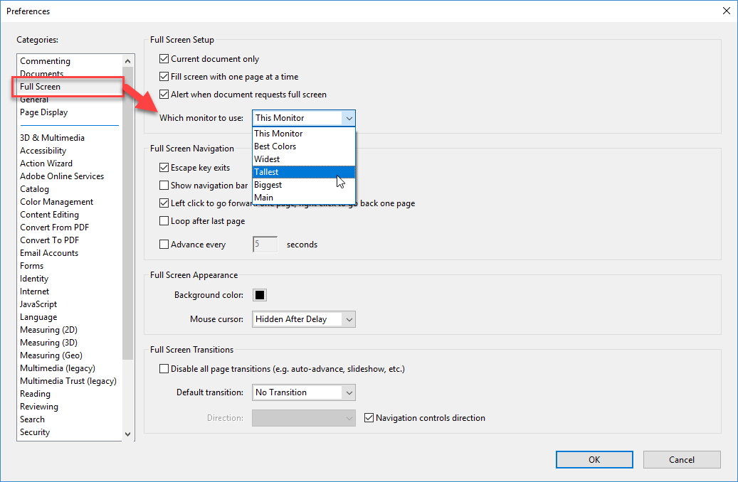
Full Screen Mode Options
Can specify which monitor will display Full Screen Mode.

Slide 25
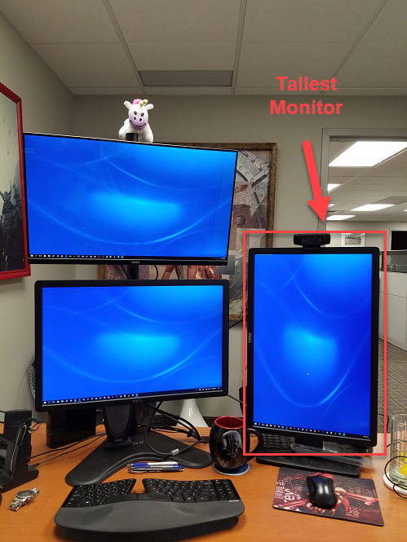
Full Screen Mode Options
Can specify which monitor will display Full Screen Mode.

Slide 26
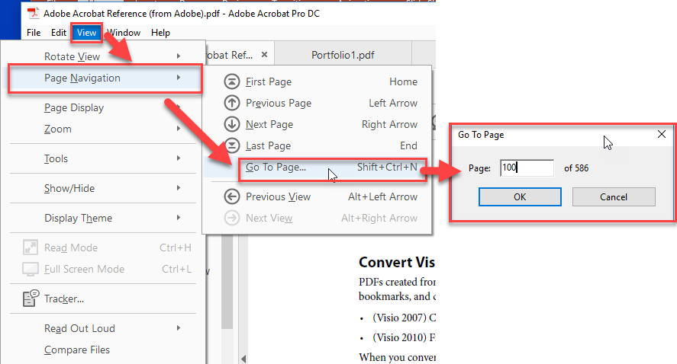
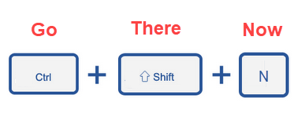
Go to a Particular Page

Slide 27
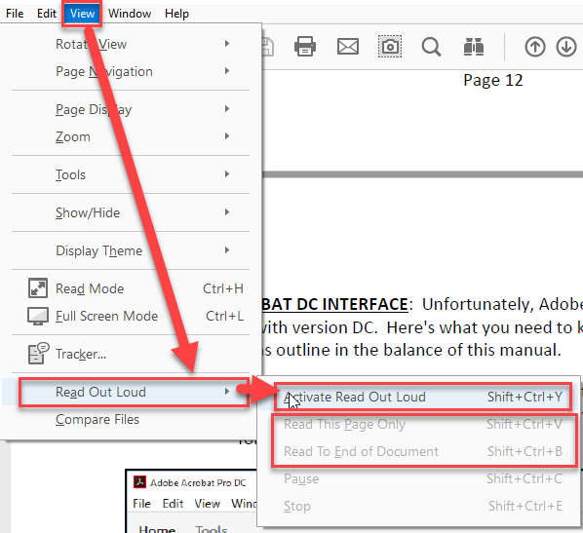
Read Out Loud

Slide 28
Find/Advanced Search
Find
Replace
Advanced Search
Indexing

Slide 29
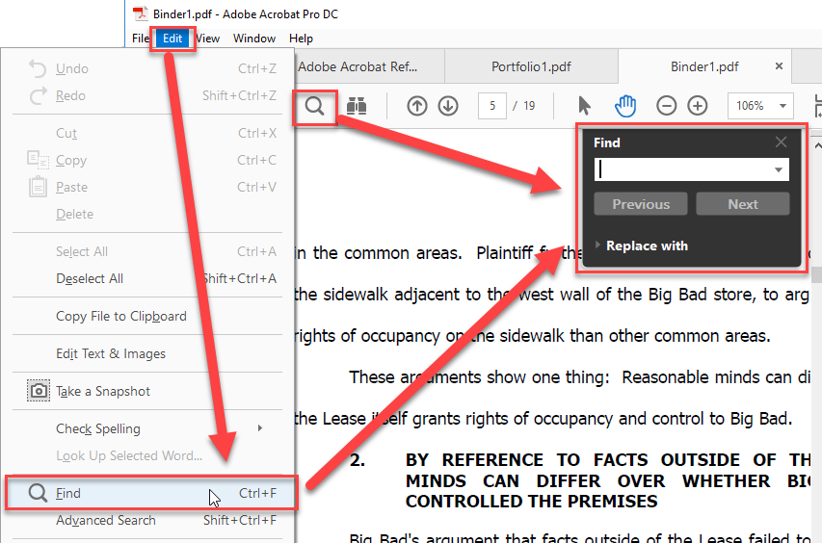
Find
Use Find to search through one PDF.
Edit->Find
Magnifying Glass Icon
CTRL+F
CTRL+G = Find Next
(Go to next)
CTRL+SHIFT+G = Find Previous (Go to previous)

Slide 30
Replace
Replace only works with a “True PDF” or a PDF that is searchable with editable text.
There is no “Replace All” feature.
When you activate the Replace feature, Acrobat will automatically activate the Edit tool.

Slide 31
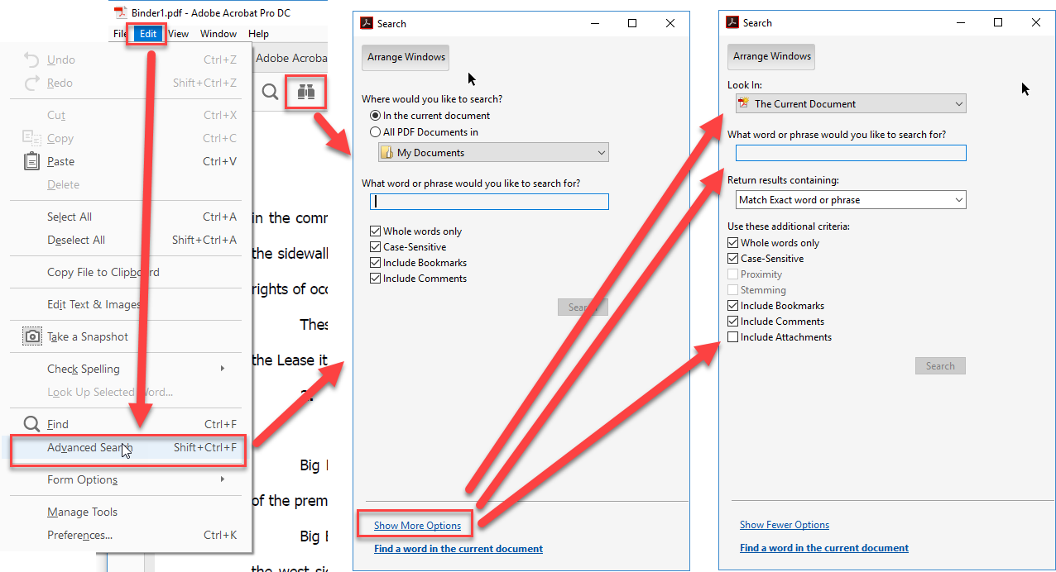
Advanced Search
Binoculars Icon, Edit->Advanced Search or CTRL+SHIFT+F.
Note the “Show More Options” link at the bottom of the window.

Slide 32
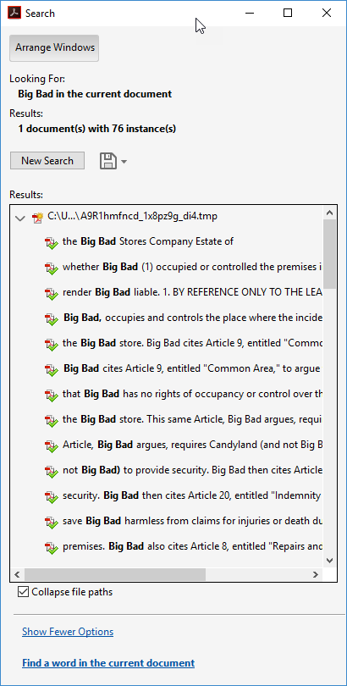
Advanced Search
Search current document
Search a folder of PDFs
Search PDF Index
Returns a list of search hits
Search results are links to location in the document(s)

Slide 33
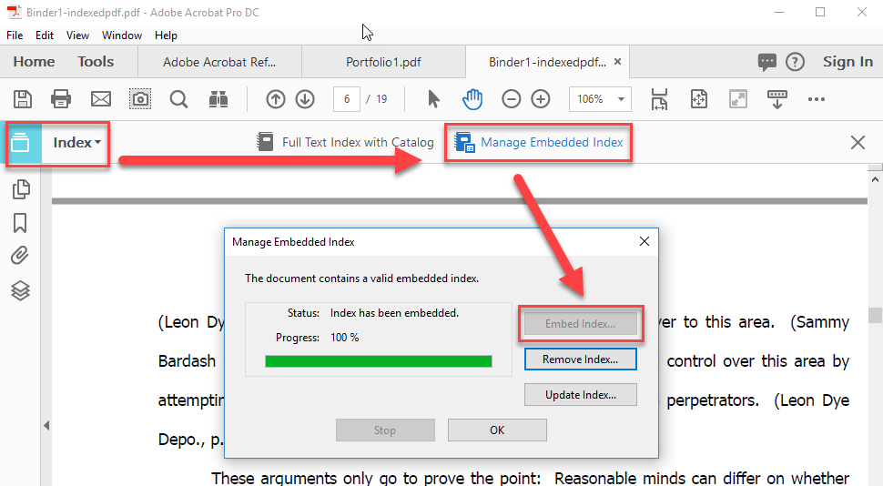
Indexing
To add a searchable index to a PDF, select the Index tool, click “Manage Embedded Index” and embed the index.

Slide 34
Creating PDFs
Create from Word
Create from Outlook
Create from Scanner
Create from Multiple Documents
  Create Single PDF from Multiple Documents
  Use Organize tool to combine
  Use Page Thumbnails to combine
Page Numbering
Page Labels
Watermarks
Create from Clipboard
Create from Web Page
Create from Printing
PDF Porfolios

Slide 35
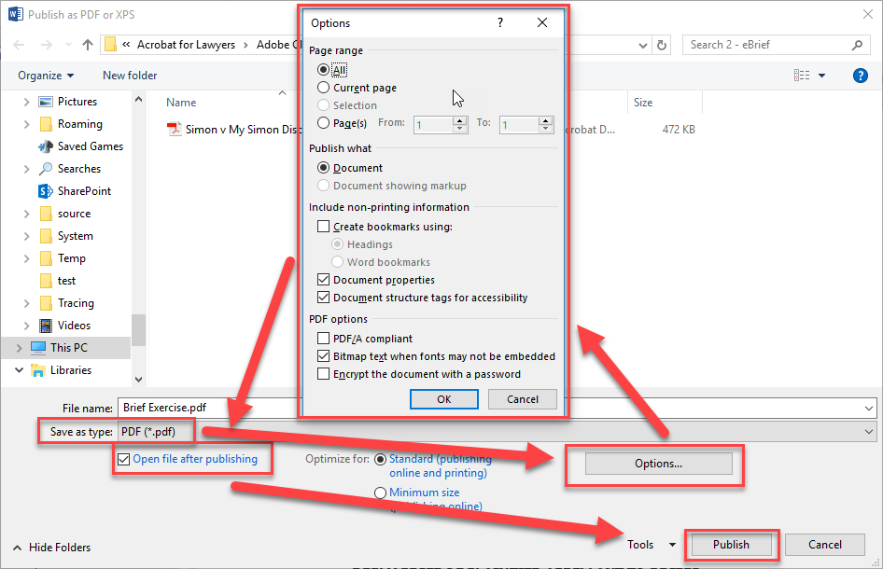
Creating PDFs from Word
Native Word Interface (without Acrobat)

Slide 36
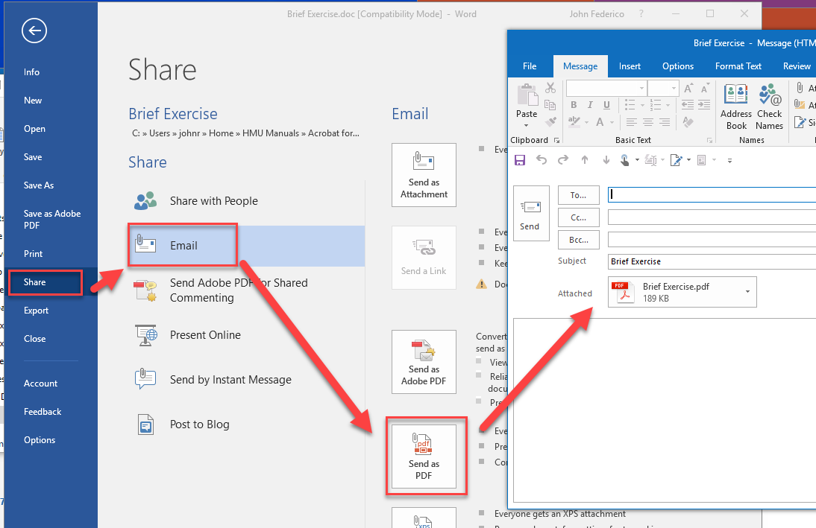
Creating PDFs from Word
Email form native Word Interface (without Acrobat)

Slide 37
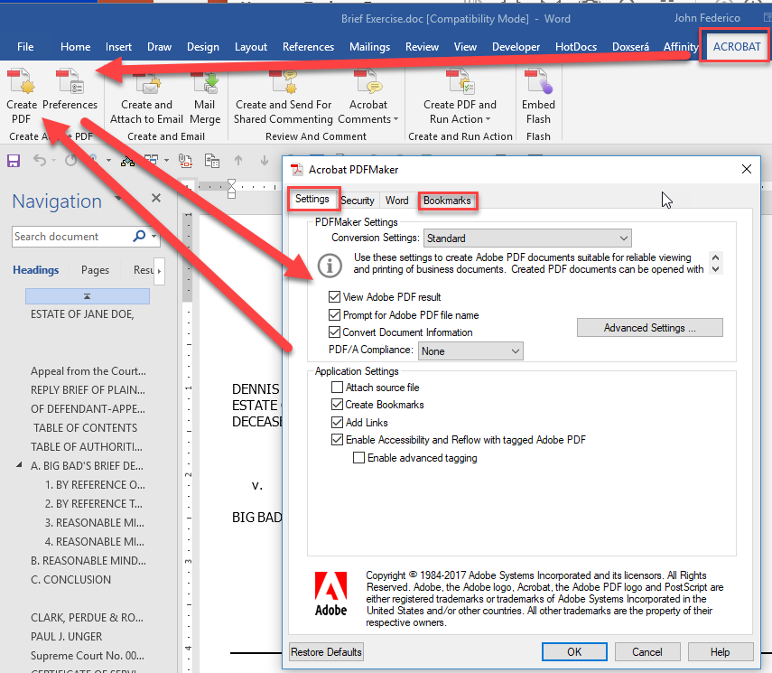
Creating PDFs from Word
Acrobat

Slide 38
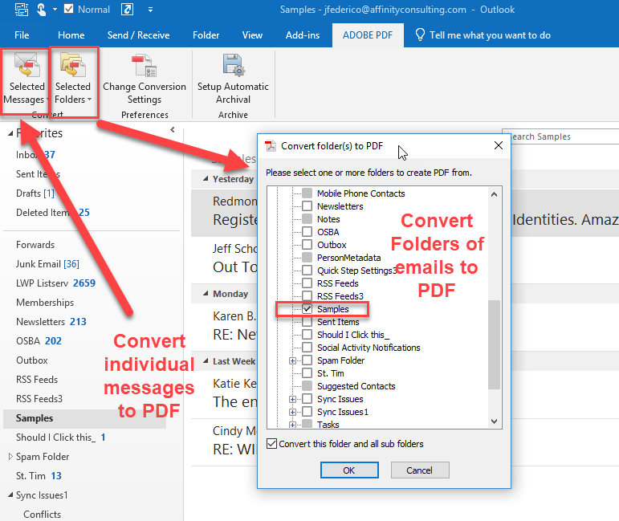
Creating PDFs from Outlook

Slide 39
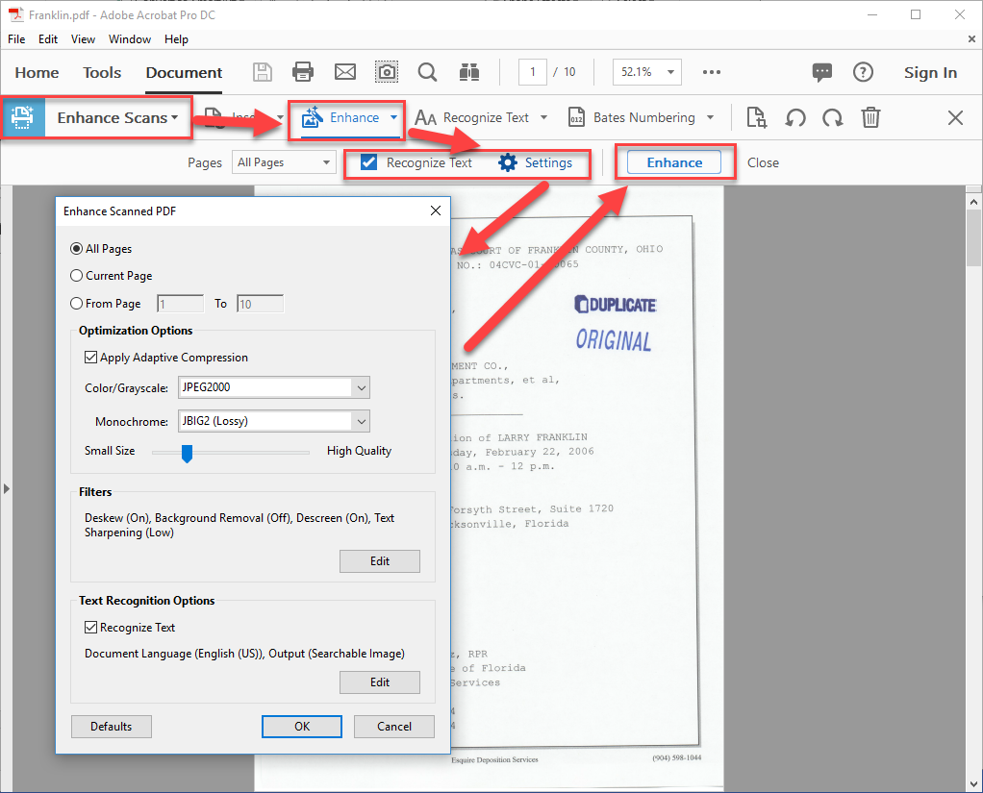
Create from Scanner
Scanner just takes a “picture” of the document
Use the Enhance Scan tool to OCR, deskew and enhance the scan.

Slide 40
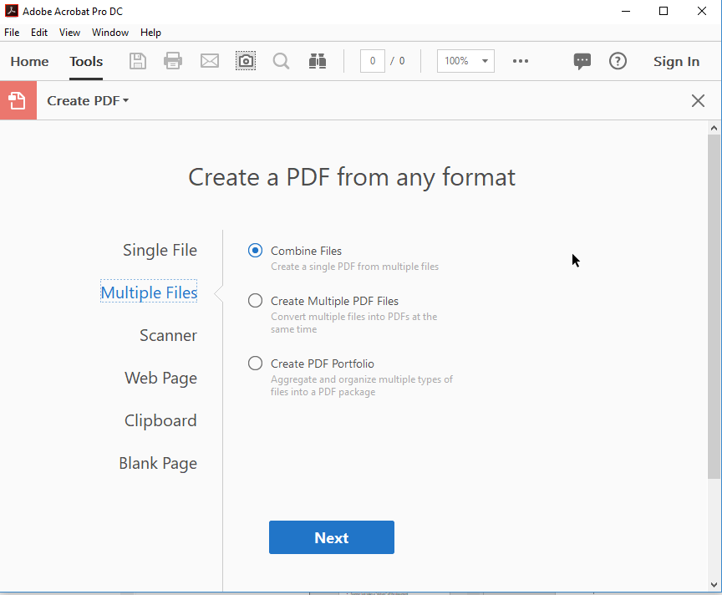
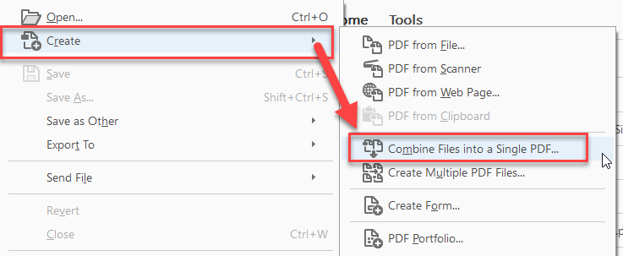
Create from Multiple Documents
File->Create->Combine Files into a Single PDF
Create Tool -> Multiple Files -> Combine

Slide 41
Create from Multiple Documents
Add bookmarks for TOC of documents
Adobe will automatically convert documents to PDF
If you use Organize or Page Thumbnails to combine documents, then you will have to manually insert the bookmarks.

Slide 42
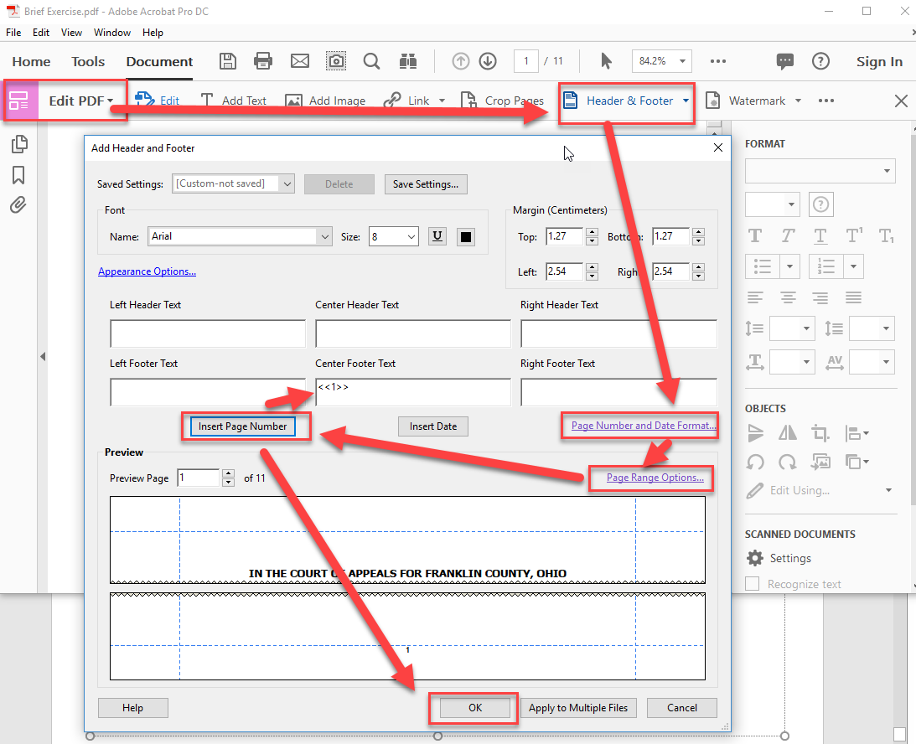
Add Page Numbering

Slide 43
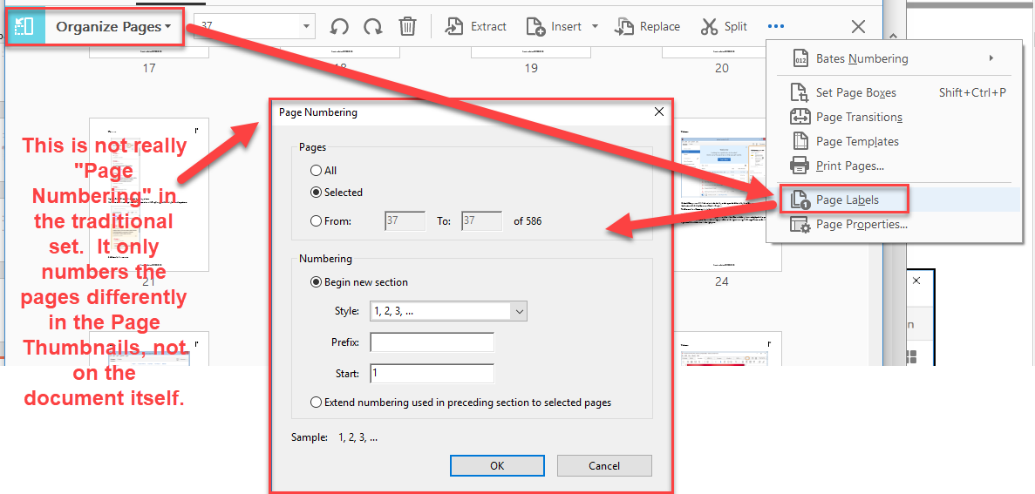
Page Labels

Slide 44
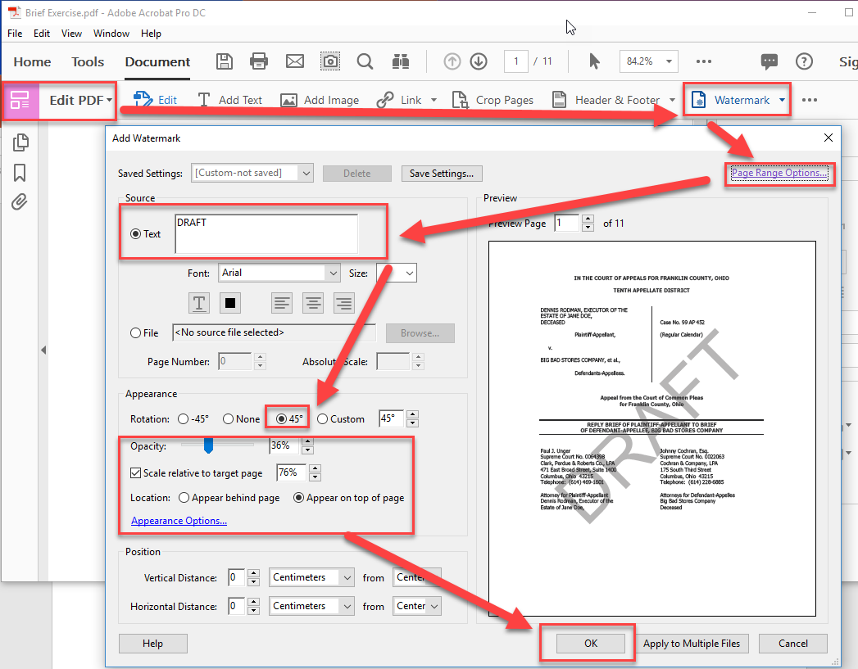
Add Watermark

Slide 45
Creating PDFs Misc
Create from clipboard
Create from a web page
Create by printing

Slide 46
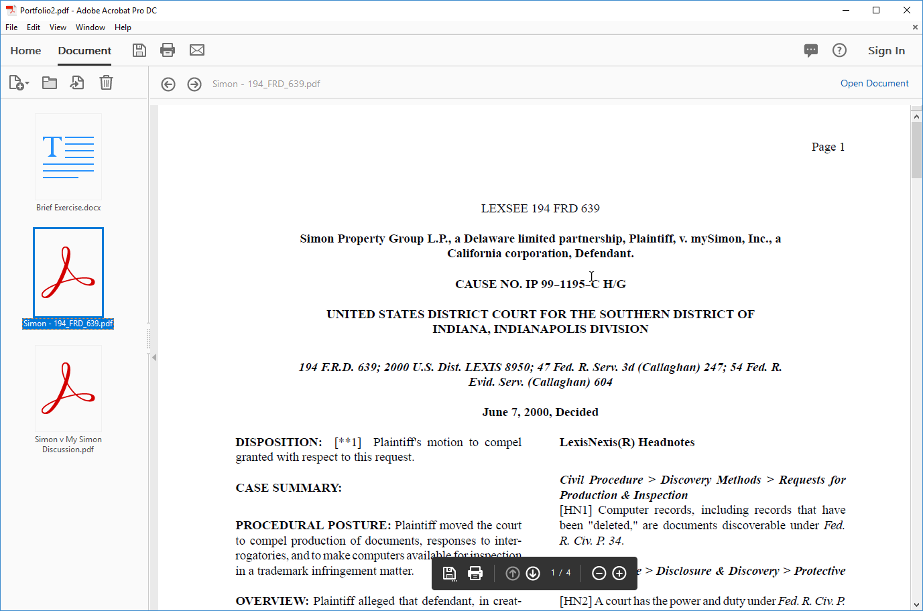
PDF Portfolios
Main difference with a Portfolio is that it contains documents other than PDFs.

Slide 47
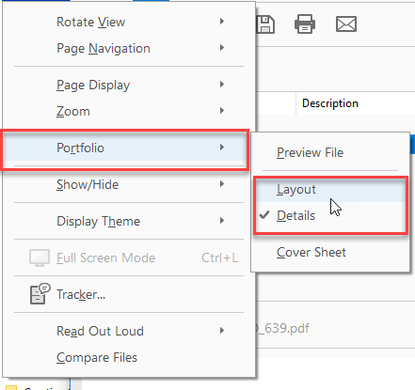
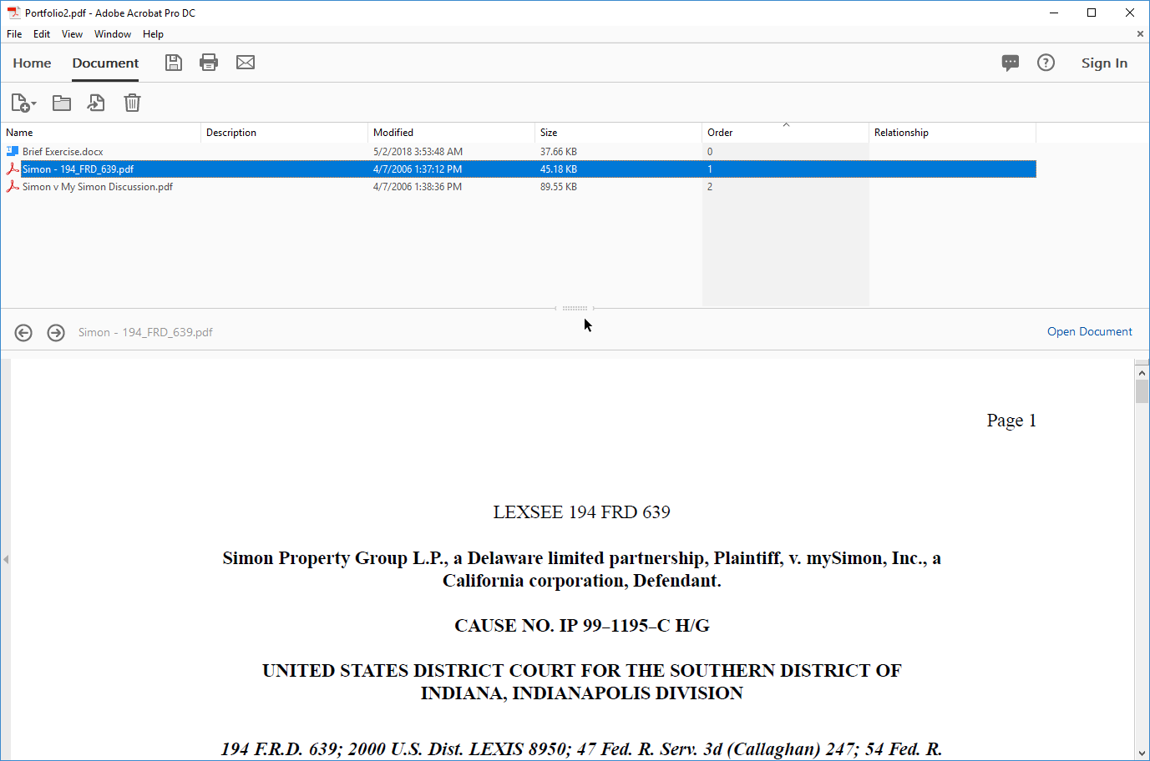
PDF Portfolios
Change the layout from the view menu.

Slide 48
Manipulating PDFs
Organize Tool
Thumbnails
Split Document
Shrink Document
Convert Document
Editing PDFs
Securing PDFs
Comparing PDFs

Slide 49
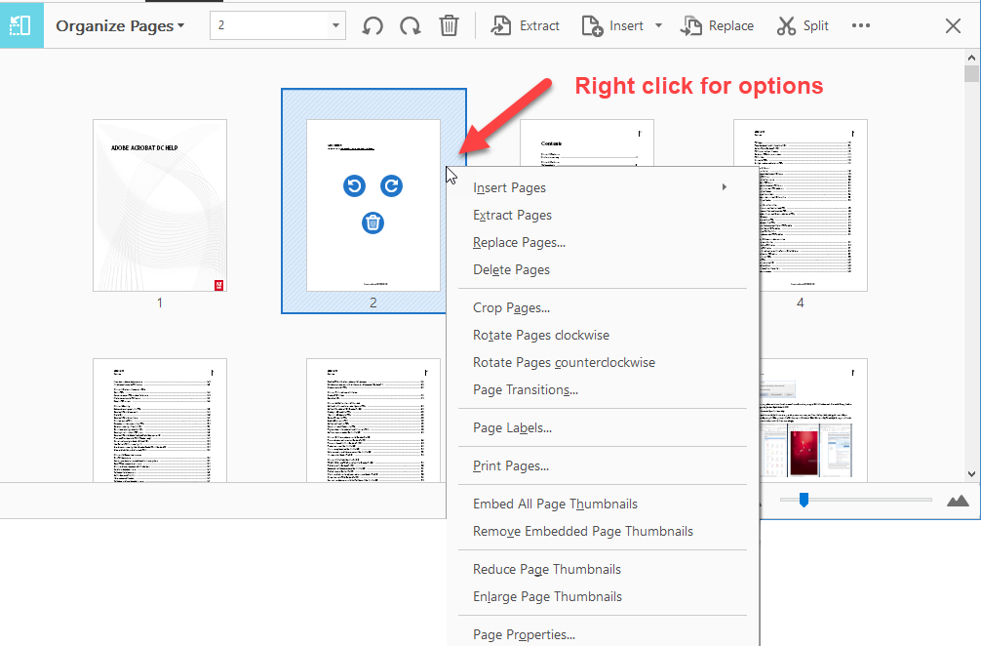
Organize Tool

Slide 50
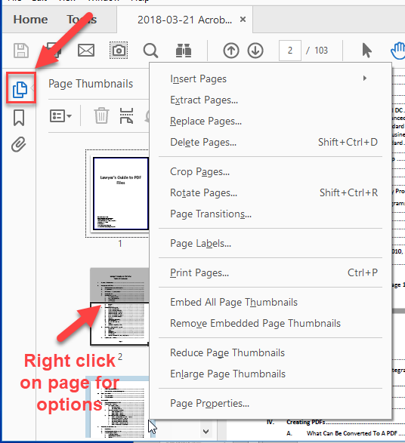
Page Thumbnails

Slide 51
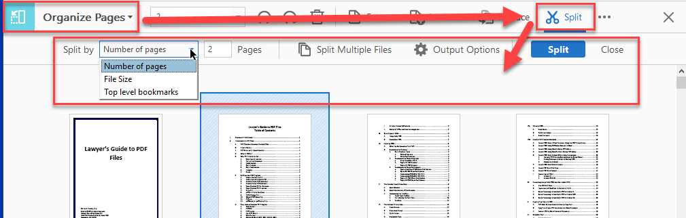
Split Document

Slide 52
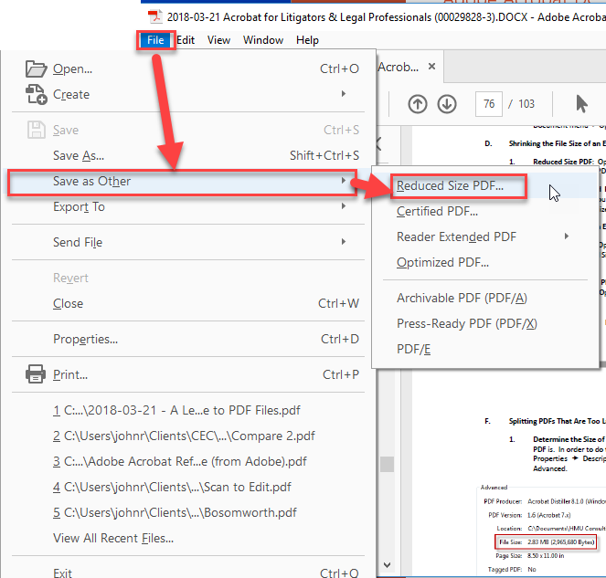
Shrink Document

Slide 53
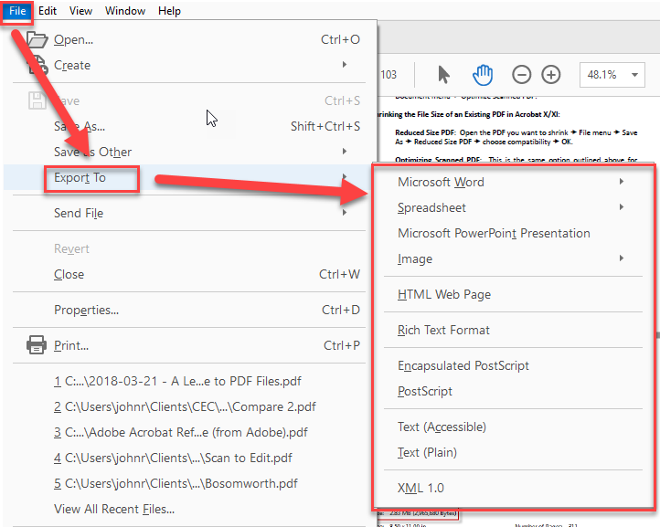
Convert Document

Slide 54
Editing PDF
Edit Tool
Scanned PDFs must be recognized for editable text
“Add Text” (Typewriter Tool) can add text to any PDF
Snapshot Tool can copy image of PDF
PDF Security
Comparing PDFs

Slide 55
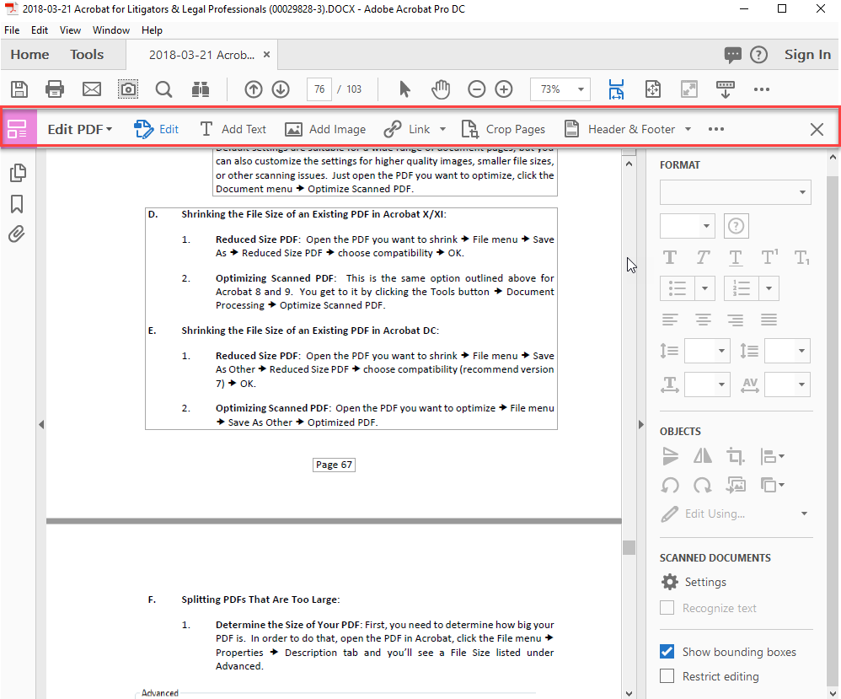
Edit Tool

Slide 56
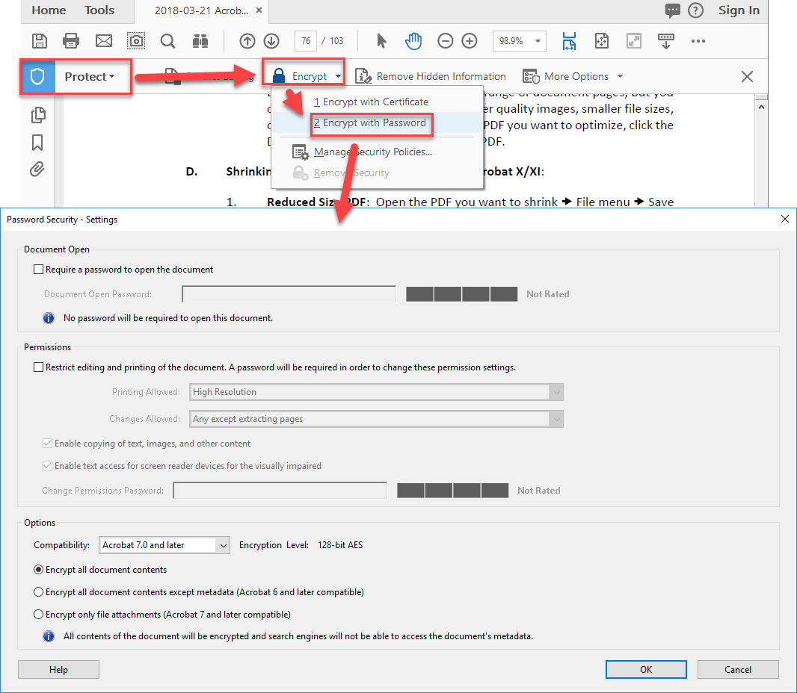
PDF Security

Slide 57
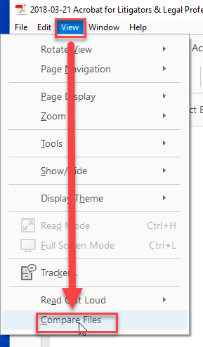
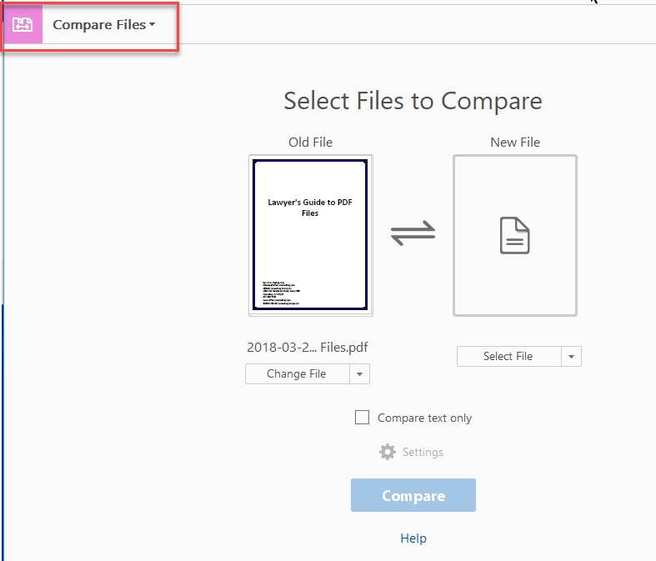
Compare PDFs

Slide 58
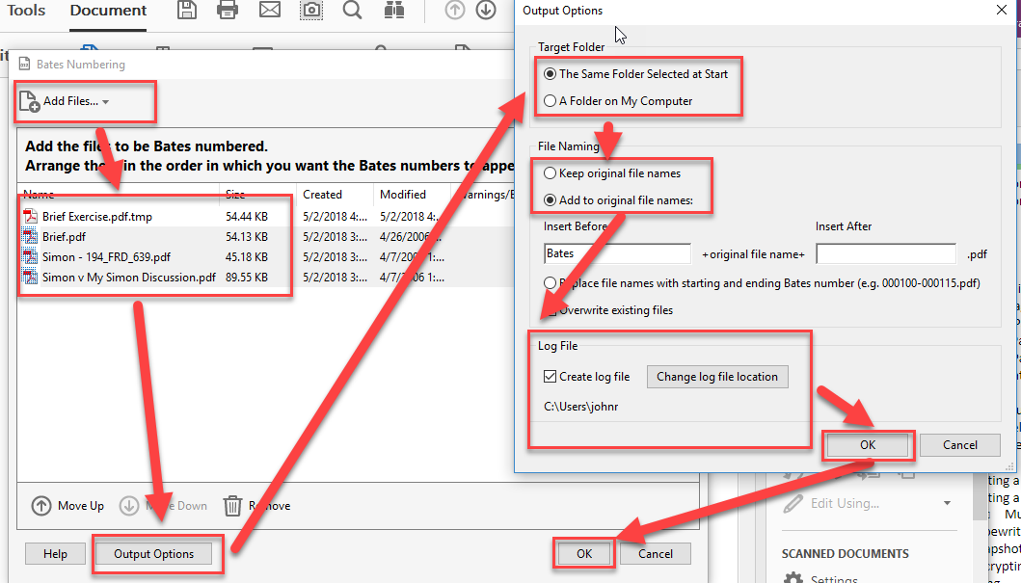
Bates Numbering Pt 1

Slide 59
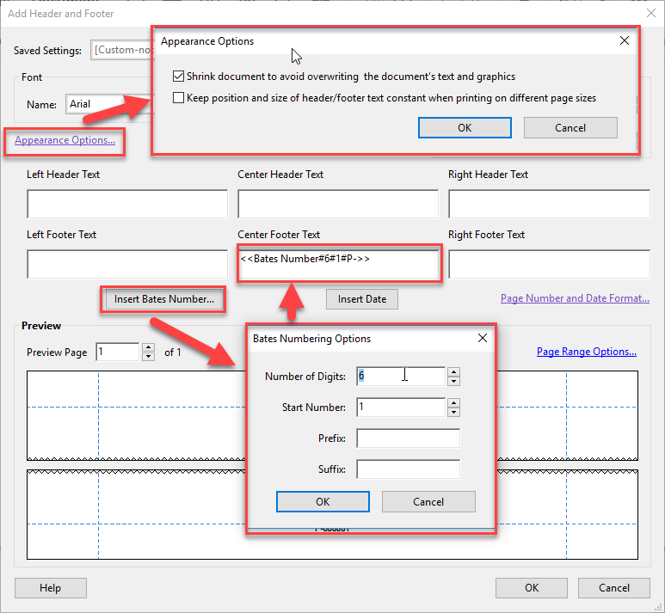
Bates Numbering Pt 2

Slide 60
Redacting
You must use the redaction tool.
DO NOT DRAW BLACK BOXES WITH THE COMMENT TOOLS!

Slide 61
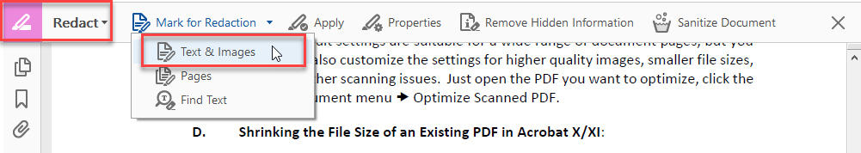
Redaction - Manual
Save your document with a different name
Mark areas for Redaction
Apply Redactions
Save

Slide 62
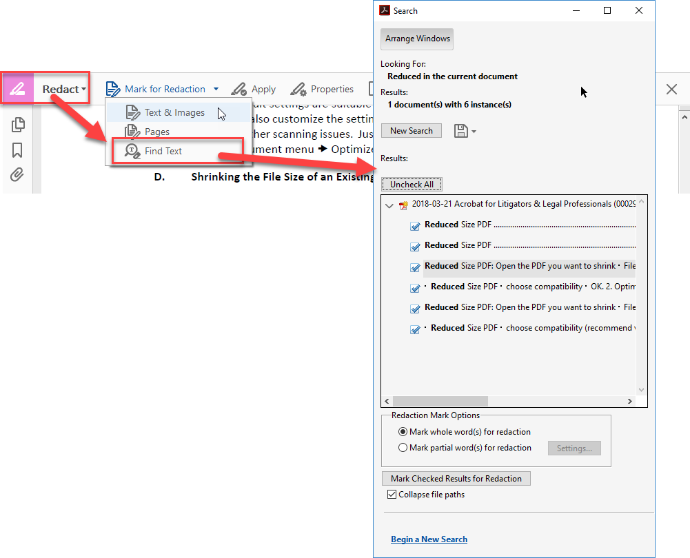
Redaction – Search and Redact

Slide 63
Comments
Comments (Comment Tool)
Shared Review (Send for Comments Tool)
  Email
  Shared Server like SharePoint
Enable Reader for Commenting

Slide 64
Signature Stamp
Stamp Tool
Signature Tool

Slide 65
Bookmarks
Adding Bookmarks
Organizing Bookmarks
Navigating Bookmarks

Slide 66
Forms
Creating Forms
Filling Forms
Making Forms Reader Enabled

Slide 67
THANK YOU
Questions?
jfederico@affinityconsulting.com

