Slide 1

WordRake
  Starting in 5 minutes
  Agenda:
    Welcome to WordRake
    WordRake Demonstration
    Enterprise Deployment
    Pilot Testing
“WordRake is perfect for anyone who wants their writing to be
less verbose and more persuasive.”
George Leloudis,
ABA Law Practice Magazine

Slide 2
WordRake
  Starting in 3 minutes
  Agenda:
    Welcome to WordRake
    WordRake Demonstration
    Enterprise Deployment
    Pilot Testing
“Before WordRake, no program gave me a return on my
investment the first day I used it.”
Sean Doherty, editor
Law Technology News

Slide 3
WordRake
  Starting in 1 minute
  Agenda:
    Welcome to WordRake
    WordRake Demonstration
    Enterprise Deployment
    Pilot Testing
“WordRake is the coolest software at the convention.”
overheard by unknown party
Gaylord National Hotel lobby
Washington, D.C.

Slide 4

WordRake
        “WordRake is my
        favorite software
        of all time.”
Randi Mayes
Former Executive Director
International Legal
Technology Association

Slide 5



WordRake
Gary Kinder, WordRake creator
Scott Johns, COO/Mgr. of Technology
Jim Figel, President/CEO

Slide 6
WordRake
Lawyer
1,000 writing programs
  WilmerHale, Sidley, Drinker, Skadden, Latham,
  Jones Day, Davis Graham, Brownstein Hyatt
  VISA, KPMG, Microsoft
  NOAA, Social Security Administration
Former writing expert for ABA
New York Times bestselling author

Slide 7
WordRake
Every Law Firm Creates Only One Product:
Ideas Conveyed in Writing

Slide 8
WordRake
  Writing is the firm’s interface with the rest of the world
    contracts
    briefs
    memoranda
    emails
    letters
    articles
    PR materials

Slide 9
WordRake
Seven U.S. patents
Only software dedicated to clarity and brevity
Harvard Law School – “Disruptive Innovation”
LexisNexis Pacific – LexisDraft Pro

Slide 10
Technical Details

Slide 11
WordRake
Add-ins for MS Word and MS Outlook
Operating Systems (32- or 64-bit):
  Windows XP, Vista, 7, 8, 10, Server 2008 R2, Server 2012
Microsoft Office (32- or 64-bit):
  Word 2007, 2010, 2013, 2016, Office 365 (except web-only client)
  Outlook 2010, 2013, 2016, Office 365 (except web-only client)

Slide 12
WordRake
Small, quick download
Only 9.5 MB total
Installer (.exe or .msi) can be deployed to all computers simultaneously

Slide 13
WordRake
Enterprise Licensing
  Custom installer embedded with organization’s enterprise license
    Eliminates license keys
    All users have same version and same expiration date
  Never communicates with the cloud or any other device
    Approved for use by US Department of Justice, US Postal Service Office of the Inspector General, US Federal Courts, and many more.
  Compatible with virtualized desktop infrastructure, remote access, highly secure environments
    Perfect record of quick, effortless deployments.
  WordRake Enterprise clients have renewed 100%.

Slide 14
WordRake
Complimentary 30-day Enterprise Pilot
  Custom installer
  Include any number in pilot
  Easy rollout
  No training needed—use immediately
  No obligation

Slide 15
WordRake
Recent Enterprise Customers Include:
    Baker & McKenzie Polsinelli
    U.S. District Court, WA Dorsey & Whitney
    FedEx Reinhart Boerner
    Littler Mendelson Ogletree Deakins
    Dept. of Homeland Security The California ISO
    California DOT Baker Botts
    U.S. Postal Service, OIG Southern California Edison
    U.S. Bankruptcy Court, FL FDIC
    DOD/Pentagon General Electric

Slide 16
WordRake
Pricing
  Three products - base price:
      WordRake Bundle $199/year
      WordRake for Word $129/year
      WordRake for Outlook $129/year
  Discounts
    Term: one year, two year, and three year – with three-year license, third year is virtually free
    Volume: 5% for 5 licenses/users and increase to 50% at 1500+
    Colorado Bar Member: 10%

Slide 17
WordRake
  Please visit wordrake.com
  Contact sales@wordrake.com for:
    Webinar/Demo for firm
    Price quote
    Enterprise pilot
  Or call us at: 206-650-5864
  Thank you for attending the WordRake Presentation

Slide 19
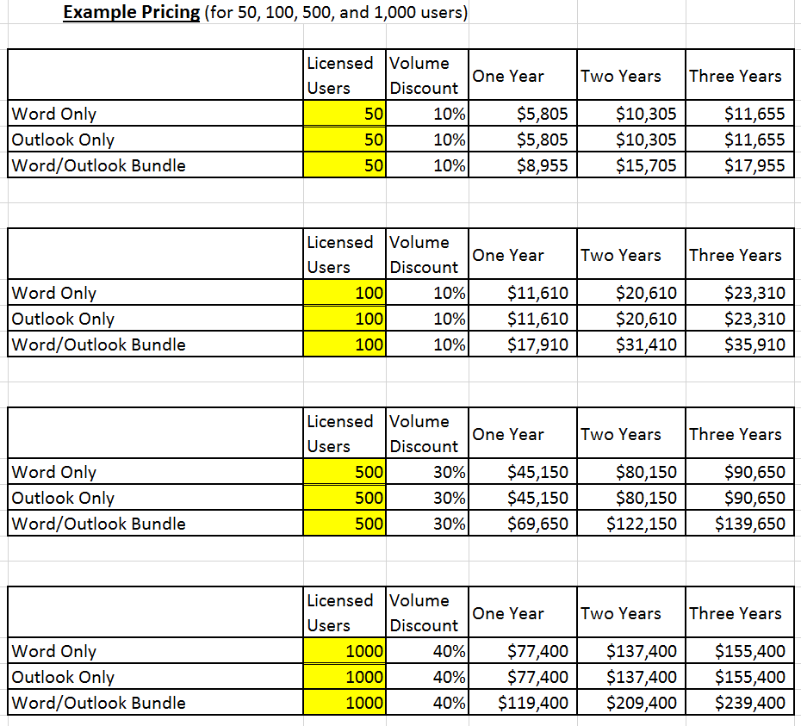
WordRake

